Slide 1

Music Manager Exercise
TMA OmniVista 2500 Core Team

Slide 2
Overview
This exercise is for new developers to get familiar with Java/Web technologies used in OmniVista Development project.
Candidates are required to implement a web application to:
  Manage songs (upload, add/edit songs profiles, delete, play).
  Provide real-time update.
  ➔ All management functions are provided to users via Web UI.

Slide 3
Architecture
Server
Client
JVM 1.7
HTML5
Server-sent-event
AngularJS
HTML5
CSS3
Tomcat 7
Spring 3
Music Manager
Restful
web-service
Hibernate 3
JDBC
MySQL

Slide 4
Server Side
Technologies used:
Spring 3
  Dependency Injection
  Hibernate Integration
Jersey 2.0 as REST service provider
MySQL to store data
Hibernate 3
  Generate the schema
  Object Relational Mapping
  Data Access Objects
  Transaction manager

Slide 5
Server Side (cont)
Source Code Directory Structure:
  API: value objects, interfaces (services)
  APP: Services implementation
  ResourceProvider: JAX-RS provider, it will call services through API component
  DAO: Database Access Objects
  Model: Entity Classes using annotation

Slide 6
Client
Technologies used:
AngularJS as MVC Framework.
ng-grid for table widget.
ng-upload for uploading files.
HTML5 <audio> tag to play music.
Listen to server updates with HTML5 server-sent-event.
Localization support.

Slide 7
Client (cont)
Source Code Directory Structure:
  /webapp contains the client code.
  /css contains styling files.
  /i18n contains localiaztion strings for the app.
  /js contains all the javascript code based on AngularJS
  /lib contains all 3rd party js libraries
  /partials contains other UI fragments (add / detail / edit / list)
  /WEB-INF contains server configuration files.
  Index.html is the master page.

Slide 8
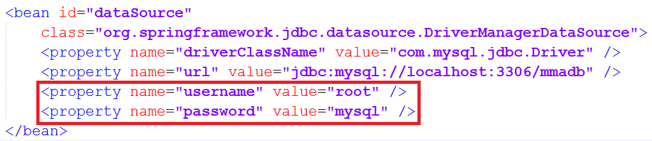
How to run the demo
Update the ApplicationContext (.. src\main\resources\META-INF) with your local database information
Build the demo project using Maven 3.x
Deploy to Tomcat server

